Slide 1
The effects of extreme climate events on avian demographics: the role of habitat refugia in mitigating climate change effects Year 2
Pat Heglund, A. M. Pidgeon, R. Akcakaya, W. Thogmartin, T. P. Albright, S. J. Vavrus, C. H. Flather, B. Bateman, J. Gorzo, V. C. Radeloff

Slide 2
Main Goals
Basic science: Predict the effects of droughts, heat waves, and cold snaps, on bird demographics
Applied science:
Quantify and enhance the role of National Wildlife Refuges and National Forests as refugia for birds during extreme events

Slide 3
Main Goals
Basic science: Predict the effects of droughts, heat waves, and cold snaps, on bird demographics
Applied science:
Quantify and enhance the role of National Wildlife Refuges and National Forests as refugia for birds during extreme events

Slide 4
Abundance declines
Mortality
Movement
Lower recruitment
Adult mortality
Out- migration
Concentrate in refugia
Notes:
This is our theoretical framework.
Alternative hypotheses for local abundance drops

Slide 5
Extreme events data
Droughts:
MODIS NDVI anomalies
Given monthly NDVI versus its mean 2003 - 2011
National Land Data Assimilation System NLDAS2
Standardized Precipitation Index (SPI)
Standardized Precipitation Deficit (SPEI)
For each day from 1979 to 2012, in windows of 1, 3, 5, 10, 15, 20, 30, 45, 60, 75, 90, 120, 150, 180, 270 days, and 1, 2, 3, 4, 5 years

Slide 6
Extreme events data
Heat Waves
MODIS Land Surface Temperature exceedances
NLDAS2
Standardized Temperature Index Maximum (STI_{max})
Spring Cold Snaps
MODIS snow cover
NLDAS2
Standardized Temperature Index Minimum (STI_{min})

Slide 7
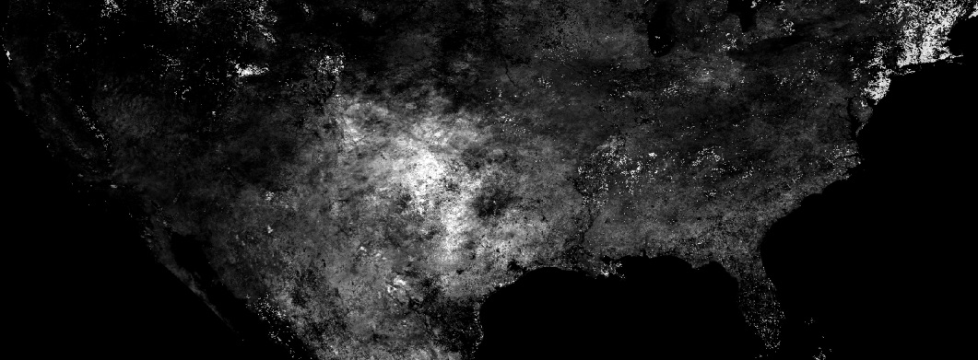
June 2011 MODIS LST exceedance
Notes:
Just some examples. Here the Texas drought of 2011

Slide 8
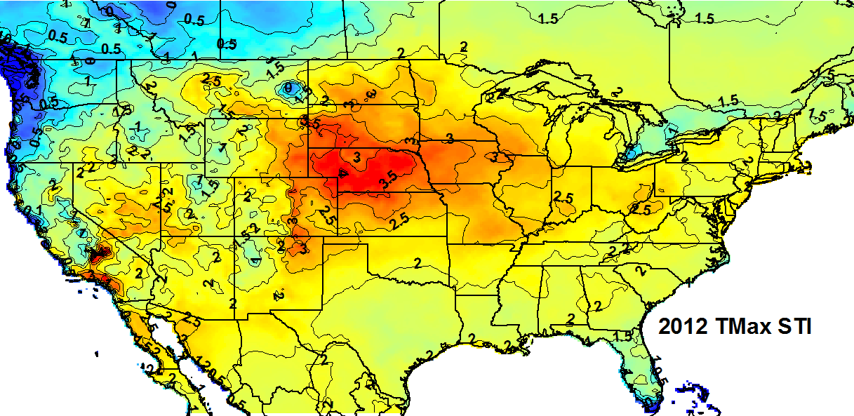
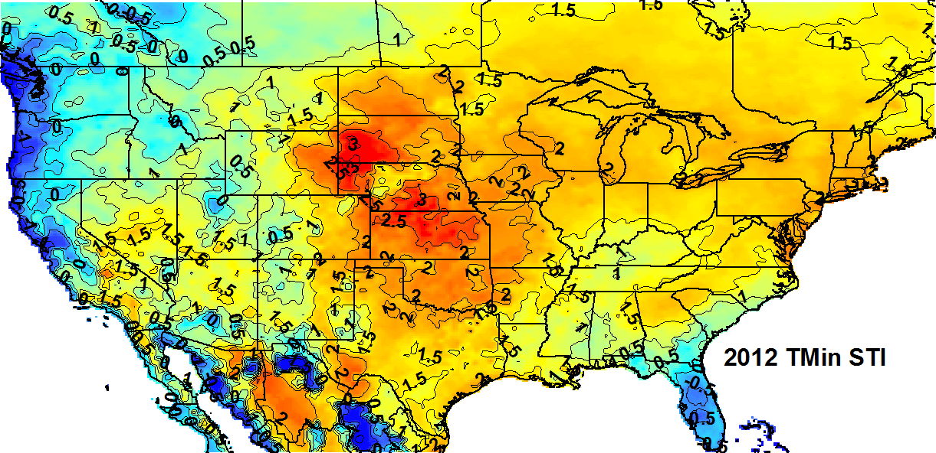
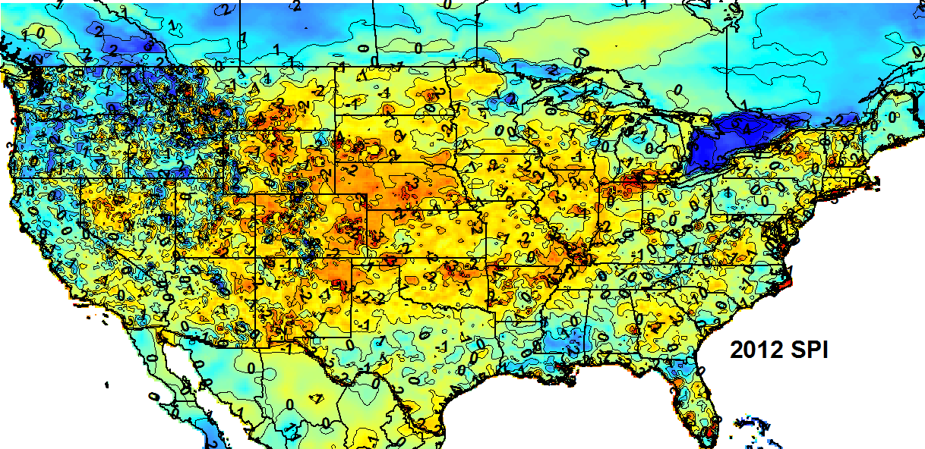
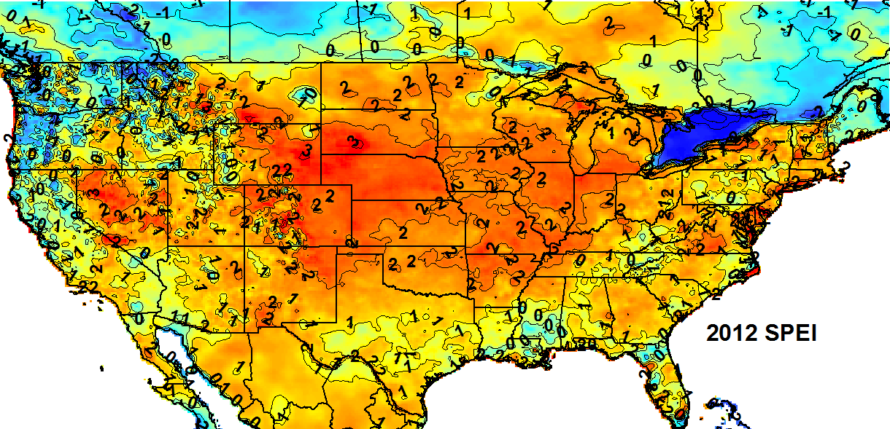
Notes:
2012 heatwave in the Midwest.

Slide 9
Notes:
We have LOTS of great data on extreme events. Working on making it available

Slide 10
Abundance declines
Mortality
Movement
Lower recruitment
Adult mortality
Out- migration
Concentrate in refugia

Slide 11
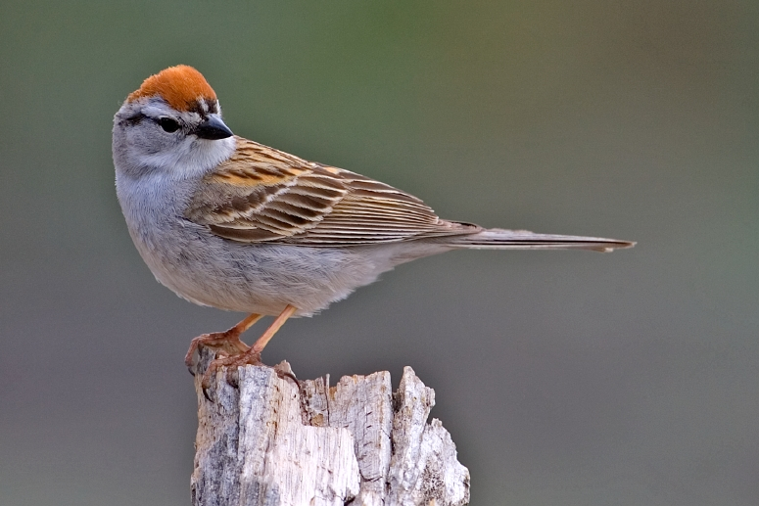
North American Breeding Bird Survey Data

Slide 12
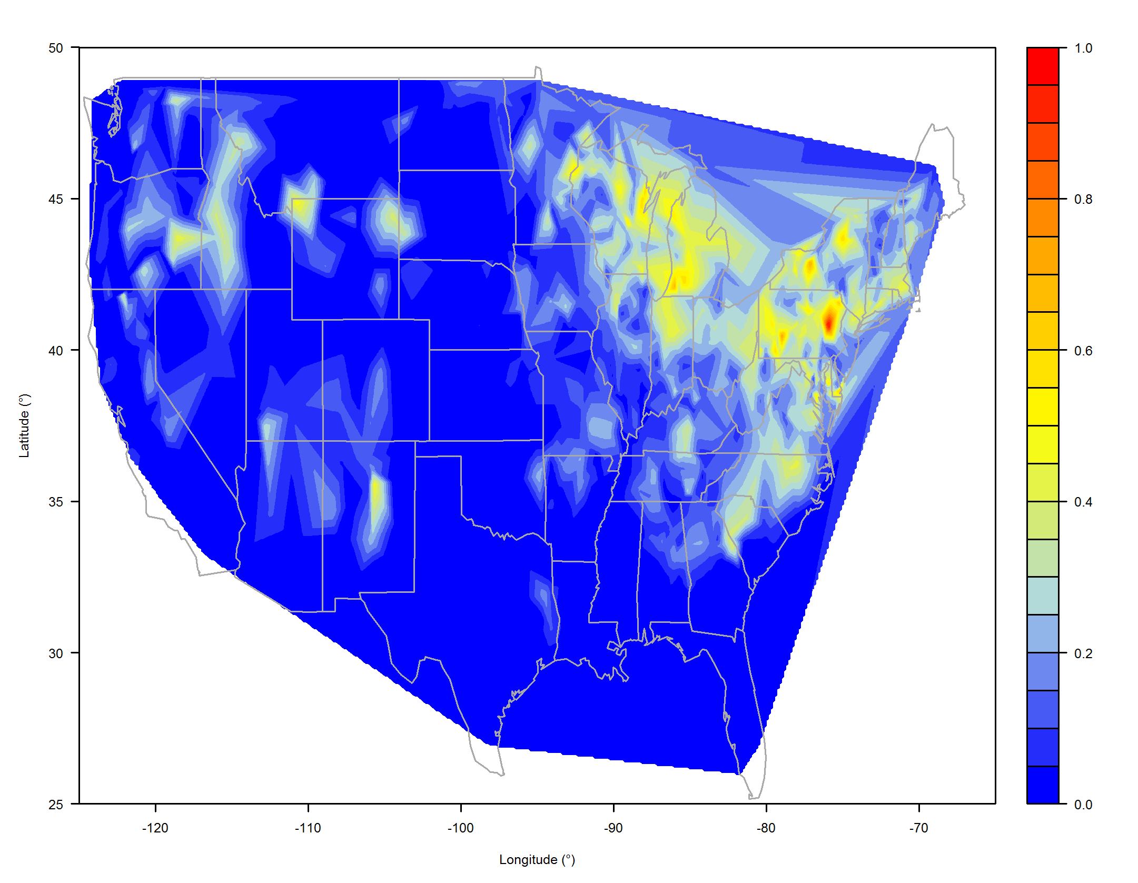
Route importance

Slide 13
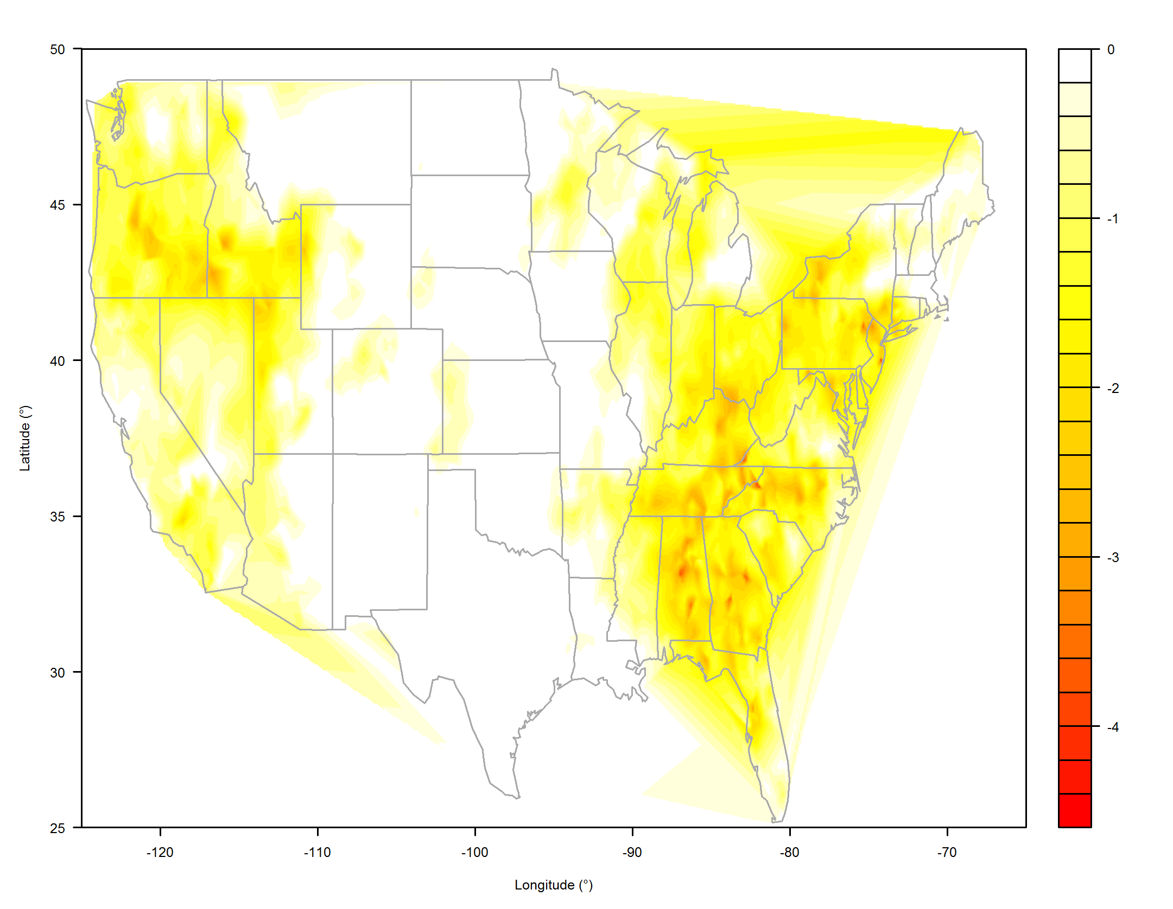
2007 May SPI

Slide 14
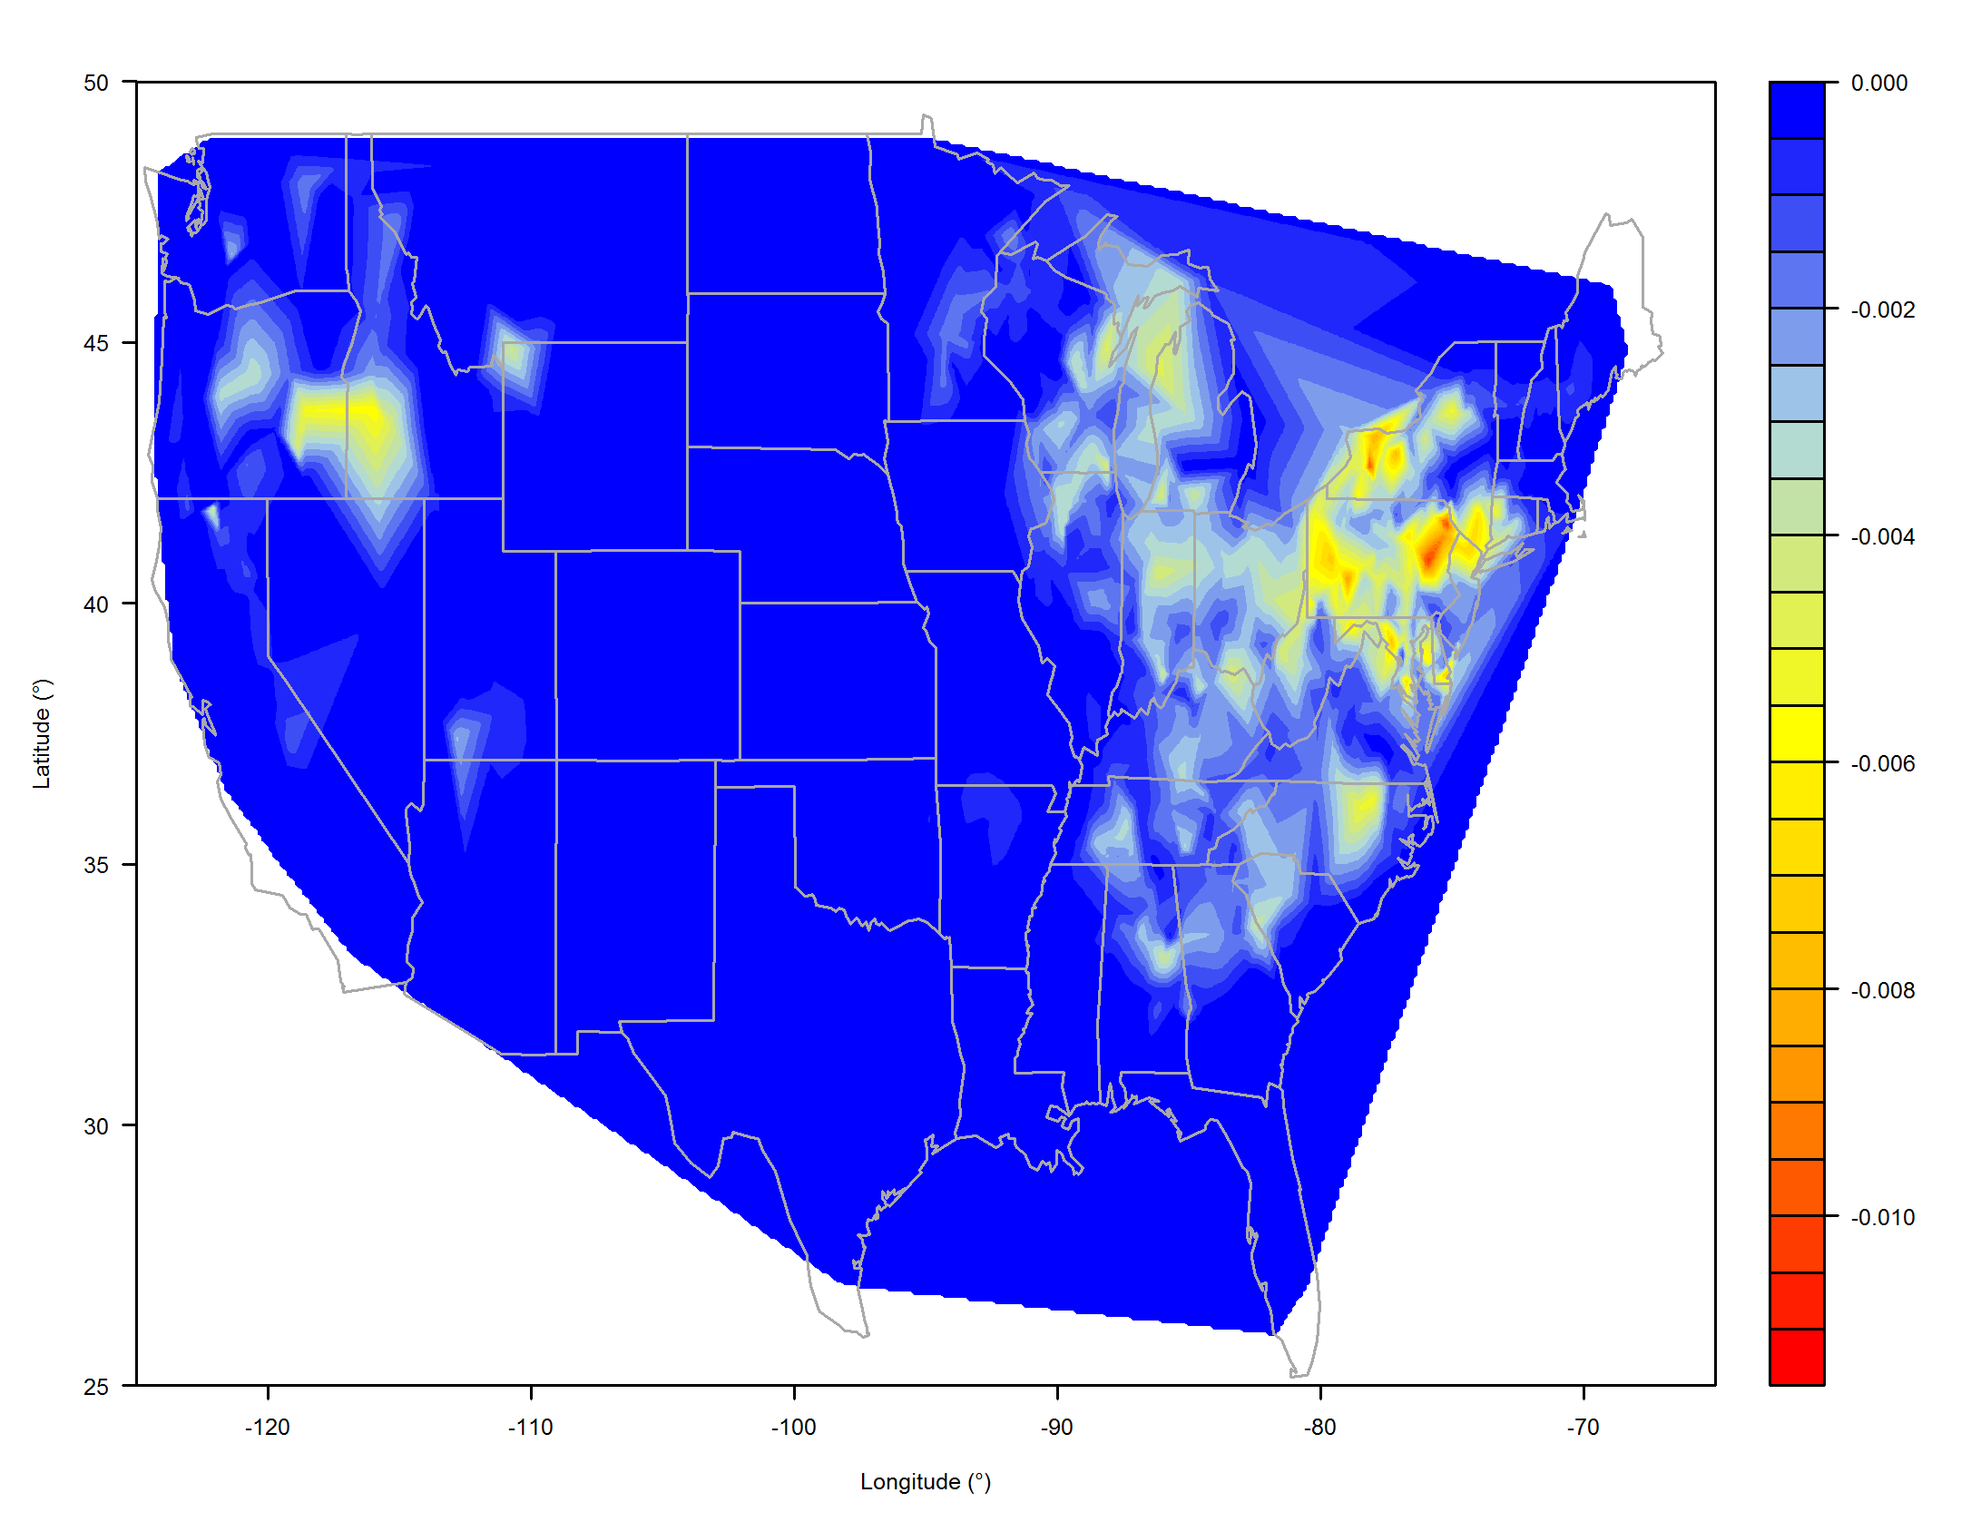
Importance x 2007 May SPI

Slide 15
Importance x 2007 May SPI
=
Magnitude of impact of May drought for Chipping Sparrow throughout their range in 2007

Slide 16
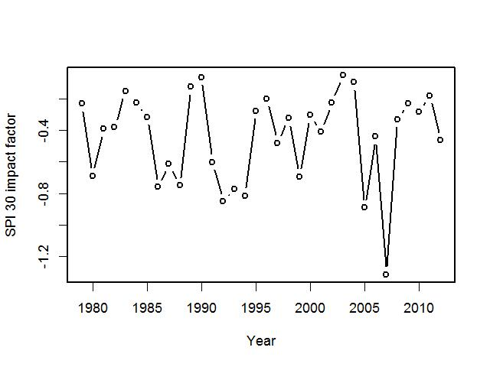
May droughts for Chippers

Slide 17
Statistical modeling
Annual abundance –> mortality
Annual deviance –> movement
For both, accounted for abundance in prior year
AIC model selection detected significance of extreme measures
Modeled drought, heat waves, and cold snaps, in May of same and prior year and in summer of prior year, for 383 species

Slide 18
Notes:
Thank heavens for postdocs!!

Slide 19
Results
Mortality due to drought in 30% of all species (116 of 383)
56 due to same year May drought
34 due to prior year May drought
43 due to prior year Summer drought
(17 due to more than one)

Slide 20
Results
Movement due to drought in 14% of all species (55 out of 383)
17 due to same year May drought
21 due to prior year May drought
24 due to prior year Summer drought
(7 due to more than one)

Slide 21
Abundance declines
Mortality
Movement
Lower recruitment
Adult mortality
Out- migration
Concentrate in refugia

Slide 22
Abundance declines
Mortality
Movement
Lower recruitment
Adult mortality
Out- migration
Concentrate in refugia

Slide 23
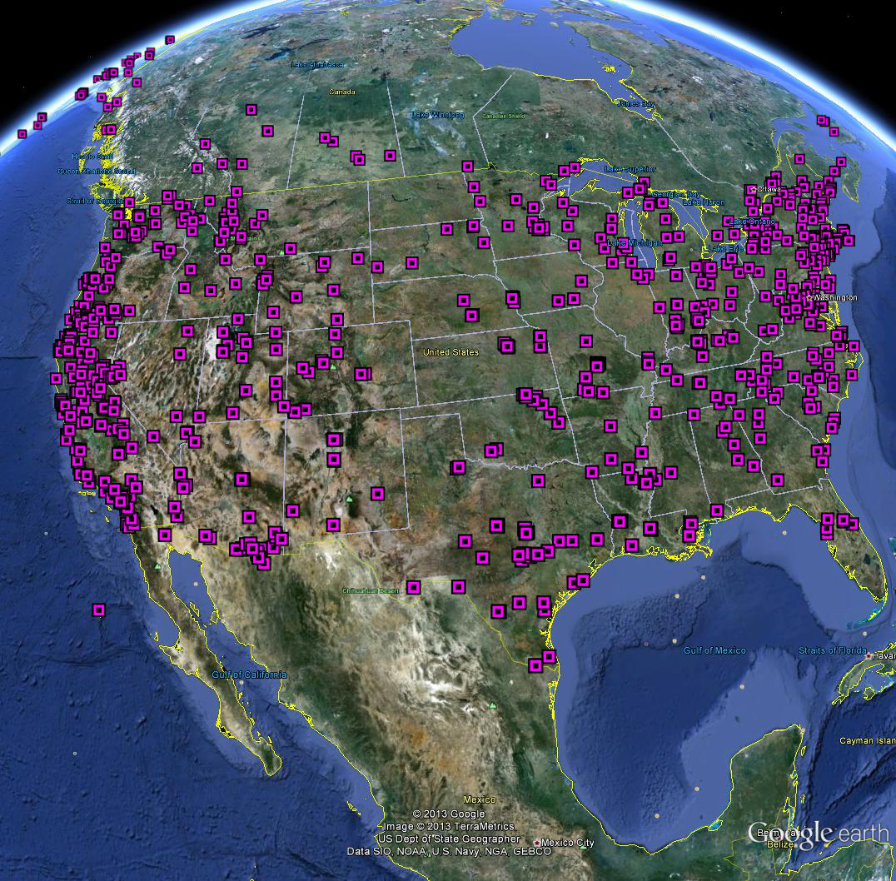
MAPS (Monitoring Avian Productivity and Survival) Stations

Slide 24
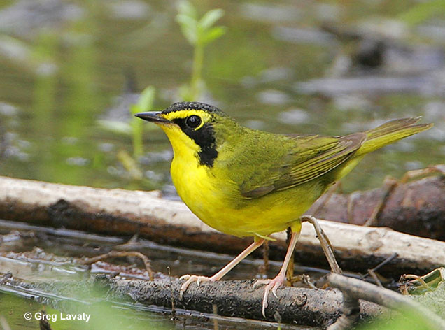

Slide 25
 | Individuals | Juveniles | Adults
1994 | 324 | 80 | 238
1995 | 315 | 100 | 209
1996 | 309 | 92 | 213
1997 | 317 | 75 | 237
1998 | 246 | 39 | 205
1999 | 324 | 104 | 218
2000 | 264 | 59 | 203
2001 | 309 | 92 | 205
2002 | 297 | 84 | 208
2003 | 45 | 8 | 36
2004 | 256 | 57 | 196
2005 | 435 | 111 | 300
2006 | 433 | 104 | 292
2007 | 477 | 113 | 321
2008 | 452 | 112 | 321
2009 | 239 | 103 | 127
2010 | 227 | 94 | 89
2011 | 145 | 24 | 118
2012 | 239 | 92 | 143
Grand Total | 5653

Slide 26
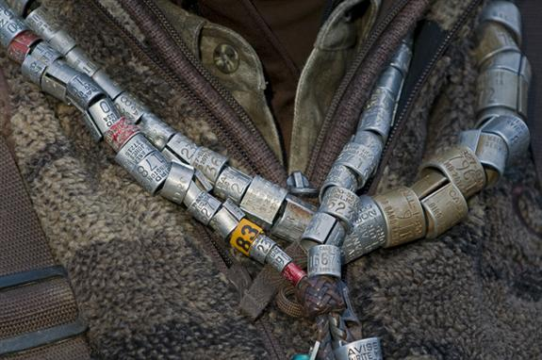

Slide 27
6,900,000 Mallards
3,400,000 Canada geese
1,700,000 Blue-winged teals
1,600,000 Wood ducks
…. ….

Slide 28
Abundance declines
Mortality
Movement
Lower recruitment
Adult mortality
Out- migration
Concentrate in refugia
Notes:
Stay tuned

Slide 29
Abundance declines
Mortality
Movement
Lower recruitment
Adult mortality
Out- migration
Concentrate in refugia

Slide 30
Abundance declines
Mortality
Movement
Lower recruitment
Adult mortality
Out- migration
Concentrate in refugia

Slide 31
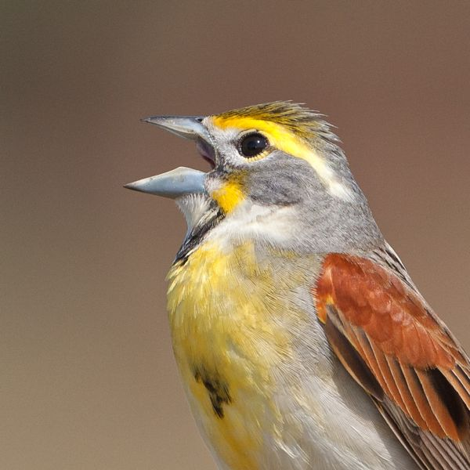

Slide 32
Dickcissel suitable weather space

Slide 33
Normal year - 2011
Dickcissel abundance
Weather suitability
Notes:
Summarized anomaly values within extents of BBS buffers
Deviance – how much does abundance in a given area differ from long term average, in response to extreme event?

Slide 34
Drought year - 1988
Dickcissel abundance
Weather suitability

Slide 35
Dickcissel
Notes:
Deviance – how much does abundance in a given area differ from long term average, in response to extreme event?
ADD chart of weather anomaly for core that brooke showed us last week.

Slide 36
Abundance declines
Mortality
Movement
Lower recruitment
Adult mortality
Out- migration
Concentrate in refugia

Slide 37
Main Goals
Basic science: Predict the effects of droughts, heat waves, and cold snaps, on bird demographics
Applied science:
Quantify and enhance the role of National Wildlife Refuges and National Forests as refugia for birds during extreme events

Slide 38
Notes:
Coded according to the definitions of the National Gap Analysis Pogram
Gap 1-2 public lands with a protection mandate
Gap 3-4 public lands that are multiple use or do not have a protection mandate

Slide 39
Species of Greatest Conservation Need
 | Inside | Outside
Appalachian | 57% | 31% *
Northwoods | 47% | 29% *
Western Mountains | 39% | N/A
Prairie | 66% | 39% *
Desert | 53% | 48%
Great Basin | 39% | N/A
* p < 0.05
Notes:
Results of Kruskall Wallace test of differences (nonparametric analog of one way anova)
In wi, 39 SGCN sp are likely picked up on BBS (back of envelope estimate), of the ~ 100 northwoods species likely picked up on WI bbs routes

Slide 40
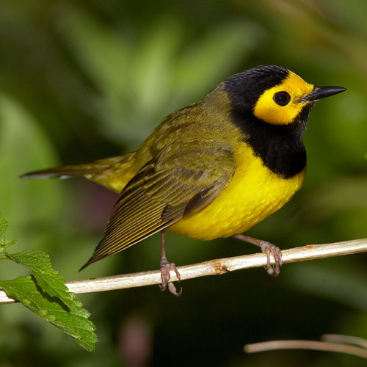
Notes:
Here see protected areas overlaid

Slide 41
Suitable weather space 1950-2011
Notes:
Here see protected areas overlaid

Slide 42
Suitable Climate space 2050
Notes:
Here see protected areas overlaid -

Slide 43
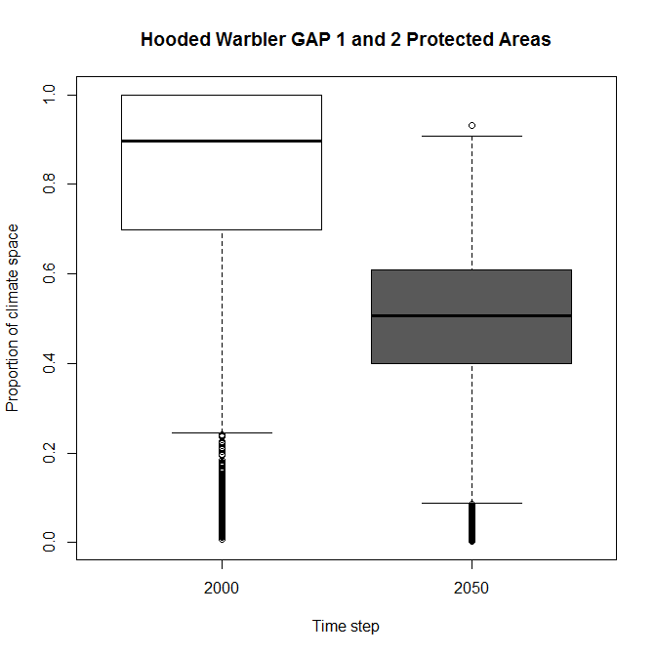
Hooded Warbler: suitable Climate space 2050
Notes:
Here see protected areas overlaid -

Slide 44
Conclusions

Slide 45
Notes:
All the datasets in place, both for extreme events, and for bird responses

Slide 46
Abundance declines
Mortality
Movement
Lower recruitment
Adult mortality
Out- migration
Concentrate in refugia
Notes:
The main response is Mortality (30 % of species), but Movement also common (15% of species)

Slide 47
Abundance declines
Mortality
Movement
Lower recruitment
Adult mortality
Out- migration
Concentrate in refugia
Notes:
Outmigration is one important movement pattern. Concentration not yet tested, nor the types of mortality

Slide 48
Notes:
Protected areas appear to be important refugia – but aren’t always in the right places given future climate change

Slide 49
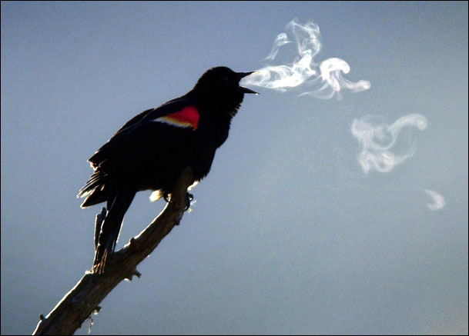
Thank
You!!

